Slide 1
Sapienza Università di Roma
International Banking
Lecture Seven
Introduction to Private Banking
Prof. G. Vento

Slide 2
Agenda
Overview and definitions
Private banking vs wealth management vs family office
Something about the private bankers and customers
State of the world’s wealth
National market’s evolution
An analysis of HNWI in Italy
Market’s players and human capital
Non financial services
Green investing
Future?
Conclusions
March 2013
Inernaional Banking - Prof. G. Vento

Slide 3

What is private banking?
Private bank’s main rule is
that there are no rules
March 2013
Inernaional Banking - Prof. G. Vento

Slide 4
What is private banking?
No generally accepted standard definition both in terms of
  products and services provided
  constitution of the client base served
but a basic definition → would be financial services provided to wealthy clients, mainly individuals and their families
March 2013
Inernaional Banking - Prof. G. Vento

Slide 5
What is private banking?
Private banking has a very long pedigree, stretching back at least as far as the 17° century in the case of some British private banks
  Small, conservative, specializing in a small sector of banking services
It is, however, only really over the last 15 years or so that the term ‘private banking’ and ‘wealth management’ has found its way.
March 2013
Inernaional Banking - Prof. G. Vento

Slide 6
What is private banking?
The provisions of:
  wealth management services,
  wealth protection for high net worth individual,
  the offering of investments services and products to support wealthy individuals’ needs
March 2013
Inernaional Banking - Prof. G. Vento

Slide 7
Products
Private banking has a greater emphasis on financial advice and is concerned with gathering, maintaining, preserving, enhancing and transferring wealth
Products include:
  Brokerage
  Core banking-type products
  Insurance and protection products, such as property and health insurance, life assurance and pensions
  Asset management in its broadest sense: discretionary and advisory, financial and non-financial assets (such as real estate, commodities, wine and art), conventional, structured and alternative investments
  Advice in all shapes and forms: asset allocation, wealth structuring, tax and trusts, various types of planning (financial, inheritance, pensions, philanthropic), family-dispute arbitration
  A wide range of concierge-type services, including yacht broking, art storage, real estate location, and hotel, restaurant and theatre booking.
March 2013
Inernaional Banking - Prof. G. Vento

Slide 8
Onshore & Offshore Wealth Management
Onshore wealth management is the provision of products and services within the client’s main country of residence.
Offshore wealth management, by contrast, serves clients wishing to manage their wealth outside their main country of residence for reasons such as:
  financial confidentiality
  legal-system flexibility
  tax considerations
  the lack of appropriate products and services onshore
  a low level of trust in domestic financial markets and governments
  the need for safety and geographical diversification in response to domestic political and macroeconomic risks.
March 2013
Inernaional Banking - Prof. G. Vento

Slide 9

Client Segments
Affluent targets clients with assets as low as 150,000-500,000 €
Private banking targets only the very wealthiest clients or high net worth individuals (HNWIs): broadly speaking, those with more than around 500,000 € (sometimes 1 million €) in investable assets.
Among countries exist relevant differences in client segmentation
March 2013
Inernaional Banking - Prof. G. Vento

Slide 10
Traditional private banking VS. wealth management
 | Traditional private banking: limits | Wealth management: key factors
Business model | Focus on financial assets (often with ‘in house’ products) | Global advisory with high value added (different assets, open architecture)
Target customer | Low threshold (sometimes affluent and upper affluent) | Very large wealths with diversified needs
Value proposition | Based on asset management | Based on advisory
Relationship manager | Broker/relational interface | Problem solver
Supply | Quite standardized and limited vision on customer’s needs | Very high personalization
Competition | Focus on price | Focus on diversification of services
Pricing policies | Relevant product’s commissions and decreasing asset management’ commissions (due to competition) | Specific pricing policy: customers do not care to pay more if they understand diversified advisory services
March 2013
Inernaional Banking - Prof. G. Vento

Slide 11
Main needs
Need | Main target | Instruments
Wealth | Firm Financial assets Non financial assets | Financial and quantitative analysis Asset management Advanced reporting Risk management Tax solutions
Life | Real estate Yacht, motors, etc. Total insurance Education and hobbies | Secretariat Concierge Insurance analysis Ad hoc advisory
Social | Philanthropic CSR Foundation Sponsorship | Qualitative and quantitative analysis Asset management Advisory
March 2013
Inernaional Banking - Prof. G. Vento

Slide 12
How does the private banke act ?
The Private Bank pursues a long term trust relation and want to be recognised and chosen for:
  independence
  transparency
  secrecy
  quality
  superior expertise of the staff
March 2013
Inernaional Banking - Prof. G. Vento

Slide 13
What do they (PBs) do ?
Customer’s knowledge and targets’ definition
Periodical review of the investment plan (also if customer’s needs change)
Info collection and strategy discussion
Strategy implementation
Very deep personal financial analysis
Definition of the investment plan and its strategic and tactical asset allocation
Inernaional Banking - Prof. G. Vento
March 2013

Slide 14
Value chain
1. Strategy
2. Delivery
3. Adjustment
Consolidation of available
informations regarding
customers
Specialized
advisory
Monitoring in
achievement
(Investment’s target)
Analysis of relevant
events for wealth
Product picking
Choices review
Global strategies’
definition
Product Execution
Strategic area with high differentiation
Specific strategies’
definition
( es.finance, art, ecc.)
Area with medium
differentiation
Non strategic area
March 2013
Inernaional Banking - Prof. G. Vento

Slide 15
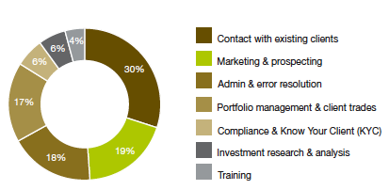
Where PBs spend their time
Source: CapGemini-Merrill Lynch, World Wealth Report, 2008
March 2013
Inernaional Banking - Prof. G. Vento

Slide 16
Market size and growth
Who are the wealthy and how much wealth do they have?
Measuring the size of the wealth management market is certainly no easy task
Frequently used metrics include:
  annual gross income
  financial assets
  total assets
  net worth (i.e. assets net of debt)
  or some combination of these
The thresholds are sometimes defined by the geographic market that the wealth management provider is targeting
March 2013
Inernaional Banking - Prof. G. Vento

Slide 17
Market size and growth
The wealth management market is probably best thought of as a group of distinct submarkets, based on client wealth bands
Again, institutions vary considerably in how they define these wealth bands and in how they label them
Broadly, as we have already said, the market can be initially divided into two subgroups – affluent and high networth – with, in turn, further subsegmentation within each especially the last one
March 2013
Inernaional Banking - Prof. G. Vento

Slide 18
Minimum requirement ?
There is no industry-wide minimum requirement for the bankable assets entry criterion
In any case, the minimum account size often reflects the bank’s aspiration rather than reality
  even at the most upscale institutions, the average account size is usually below the minimum asset requirement
During the late 1990s, many banks moved down market and accepted clients who did not fulfil their communicated entry criteria
Over the long term, real entry thresholds for many players have fallen
March 2013
Inernaional Banking - Prof. G. Vento

Slide 19
Minimum requirement ?
There are generally no official government or private statistics on the actual distribution of wealth within individual countries
Not unnaturally, many individuals deliberately attempt to conceal the exact size of their wealth, and a large proportion of wealth may be held not only in secret accounts and trusts but also in assets that are illiquid and/or not publicly quoted
Furthermore, it is often difficult to draw a distinction between an entrepreneur’s corporate and personal wealth
March 2013
Inernaional Banking - Prof. G. Vento

Slide 20
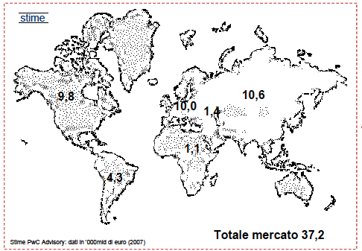
Private banking: World market
Values in %
Europe and North America: 26%
Asia and Pacific areas: 28%
Latin American: 12%,
Middle East: 4%
Africa: 3%
Total amount: 37.200 billion euro (2007): +1% with respect to 2006
It is very difficult to estimate the real data of PB and to assess a unique standard for PB due to:
  different definitions of PB among countries
  different inclusion of financial and non financial instruments among countries
  volatility due to exchange risk

Slide 21
Better understanding of client needs is fundamental
The number of private clients overall is increasing as a result of the accelerating economies of the ‘BRIC’ nations, Eastern Europe and the Middle East, as well as sustained growth in established markets.
New clients to wealth management are dominated by entrepreneurs who have built private businesses, representing a fundamental shift from traditional inherited wealth to self-made wealth
March 2013
Inernaional Banking - Prof. G. Vento

Slide 22
Future scenario
which elements will probably change PB’ markets (global) ?
Economic
recession
financial crisis
real estate crisis
liquidity gap
credit crunch
international investment bank’s crisis
Political and regulatory
bank’s nationalizations
more bank supervision
Technological
new IT system for compliance, risk management and customer relationship management
Social and environmental
breakdown of confidence regarding banking system
more concentration of wealth and income
increasing uncertainty vs financial assets
intergenerational transfer
Inernaional Banking - Prof. G. Vento

Slide 23
Who acts in this market in Italy?
The first cluster of national operators, regarding market shares, includes main italian banking groups; this cluster is very diversified
Very specialised private banks; usually their size is small-medium except for example for Banca Banca Aletti.
Foreign banks: this cluster includes big player (UBS, Credit Suisse, Deutsche Bank), and small player (Pictet & Co., Banca Syz, Banca del Gottardo, Banca della Svizzera Italiana, Européenne De Gestion Privée, etc.). Swiss banks are very important in our country
Sgr and Sim (Ersel, Kairos & Partners Sgr, Investitori Sgr, etc);
Banking units mainly organised with network of financial advisors (Banca Fideuram, Azimut Consulenza Sim, Banca Generali, Banca Euromobiliare, Intra Private Bank, etc.);
Family Office: is specially designed for families of exceptional wealth and the professionals they call upon to help run their affairs. The services they offer are devised to meet the particular needs that come with owning substantial family assets.
March 2013
Inernaional Banking - Prof. G. Vento

Slide 24
Non-financial ‘lifestyle’ services
Non financial lifestyle services are an umbrella term referring to a wide range of services designed to support, facilitate and improve the lifestyles of wealthy clients
Includes:
  Lifestyle organization services aimed at assisting in organizing and facilitating aspects of individuals’ lives such as leisure, entertainment, shopping and event planning
  Travel services aimed at supporting and arranging individuals’ travel requirements
  Property and home services aimed at assisting with individuals’ household and property requirements including finding, purchasing, moving and maintaining the home
  Luxury asset acquisition services aimed at helping wealthy individuals in the purchase and management of large-scale luxury items
March 2013
Inernaional Banking - Prof. G. Vento

Slide 25
Real Estate Advisory
A Real Estate advisory unit (or division or specialist) usually provides the following services:
  Evaluation of real estate assets and portfolios
  Assistance in sale & purchase transactions
  Real estate project development
March 2013
Inernaional Banking - Prof. G. Vento

Slide 26
Succession planning
“Create a situation for the client that optimizes his current tax and legal situation and enables a fiscally friendly and legally justified transfer of wealth to the next generation, always tailored to the individual wishes and circumstances”
Succession (i.e. the transfer of an individual’s estate as a consequence of his death) can be a serious problem under some jurisdictions, mostly due to:
  Inheritance (and/or donation) tax
  Forced heirship rules
  Heirs litigation
  Special family situations (divorced, disabled, underage…)
March 2013
Inernaional Banking - Prof. G. Vento

Slide 27
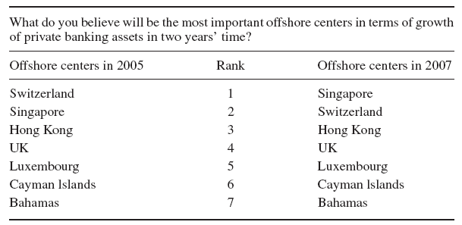
Growth in offshore private banking assets
Source: IBM Consulting Services (2005). European Wealth and Private Banking Industry
Survey 2005, IBM Business Consulting Services.

Slide 28
During 2009 - 2011 ….
2009 - 2011 were difficult years
Decreasing revenues and fees (less stock, less transactions, simple products with low fees, etc.)
Need of certainty (government bonds, high rating, less alternative investments, etc.)
Organizations in some case will change or reduce structural and human capital
Less ‘in house products’ and more ‘advisory services’
True value added is not linked to continuous product innovation
Future is based on credibility and quality
Customers will ask simplicity before false disclosure
March 2013
Inernaional Banking - Prof. G. Vento

